Slide 1
Infrared
Infrared interfaces are used in remote control units of TV, VCR, air-conditioner, etc.
These interfaces are all based on proprietary protocols.
Infrared interfaces are now commonplace for a number of devices such as palmtops, cell phones, digital cameras, printers, keyboards, mice, LCD projectors, ATMs, smart cards etc.
Infrared interface provides a low-cost, short range, point-to-point communication between two devices.
The only drawback with infrared is that it operates in line of sight communication mode and it cannot penetrate through walls.

Slide 2
Infrared
IrDA module shows the device with infrared transceiver.
The transmitter is LED and receiver is a Photodiode.
For low data rates the processor of the embedded system itself can be used whereas for high data rates, a different processor may be needed.
The data to be sent on the infrared link is packetized and encoded as per the IrDA protocols and sent over the air to the other device.
The receiving device will detect the signal, decode and depacketize the data
Processor
UART/Packetizer
Encoder/Decoder
Transceiver
LED, Photodiode
Fig 5. IrDA Module

Slide 3
Infrared
For the communication through infrared Interface, the IrPHY and IrLAP are specified in the standard.
Link Management is done through IrLMP, above which the Application layer protocols will be running.
Fig 6. Protocol Architecture

Slide 4
Infrared
Physical layer: IrPHY specifies the data rates and the mode of communication. IrDA has two specifications viz., IrDA Data and IrDA control. IrDA Data has a range of 1 meter with bi-directional communication. Serial IR (SIR) supports data rate up to 115 Kbps and Fast IR (FIR) supports data rates up to 4 Mbps. IrDA Control has a range of 5 meters with bi-directional communication speed up to 75 Kbps. A host such as PC can communicate with 8 peripherals using IrDA protocols.
Data Link layer: IrLAP is based on HDLC protocol. Master/slave protocol is used for communication between two devices. The device that starts the communication is the Master. The master sends the command and the slave sends a response.

Slide 5
Infrared
Link management layer: This layer facilitates a device to query the capabilities of other devices. It also provides the software capability to share IrLAP between multiple tasks.
Higher layers: The higher layer protocols are application specific. IrCOMM protocol emulates the standard serial port. When two devices such both fitted with infrared interface come face to face, they can exchange the data using the application layer protocols.

Slide 6
IEEE 1394 Firewire
Apple Computers Inc. initiated the development of a mechanism to interconnect consumer devices such as PC, printer, TV, VCR, digital camera, CD player using a serial bus known as Firewire.
Later on, it led to the development of the standard IEEE 1394.
The consumer devices can be connected using this serial bus. The cable length can be up to 4.5 meters.
IEEE 1394 provides plug and play capability and hot insertion capability.
Peer-to-peer communication is supported and hence even if the PC is not there, any two devices can be connected.

Slide 7
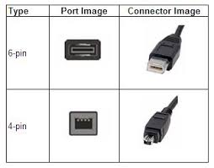
IEEE 1394 Firewire
PC
Printer
TV
VCR
CD Player
Digital Camera
Fig 7. Connecting Devices through IEEE 1394 Bus
Fig 8. Protocol architecture IEEE 1394

Slide 8
IEEE 1394 Firewire
Each device is given a 6-bit identification number and maximum of 63 devices can be interconnected on a single bus.
Using bridges, multiple buses can be connected. Each bus is given a 10-bit identification number and 1023 buses can be interconnected.
The standard specifies copper wire or optical fiber as the transmission medium with data rates 100, 200, 400, 800, 1600 and 3200 Mbps.
The functionality of various layers presented in the protocol architecture is as follows:
Physical layer: This layer specifies the electrical and mechanical connections. Bus initialization and arbitration are the functions of this layer. These functions ensure that only one device transmits data at a time.

Slide 9
IEEE 1394 Firewire
Data Link layer: The layer takes care of packet delivery, acknowledgements and addressing of the devices.
Transaction layer: This layer handles the writing and reading of the data from the devices.
Management protocols: These protocols are used to manage the bus and they run on each of the devices. These protocols do the necessary resource management and control the nodes.

Slide 10
Ethernet
Ethernet interface is now ubiquitous.
It is available on every desktop and laptop.
Availability of low-cost Ethernet chips and the associated protocol stack, providing an Ethernet interface is very easy and useful to the embedded system.
Through the Ethernet interface, the embedded system can be connected to the LAN.
The data collected by an embedded system can be transferred to a database on the LAN.
The Ethernet interface provides the physical layer and data link layer functionality.
Above the data link layer, the TCP/IP protocol stack and the application layer protocols will run

Slide 11
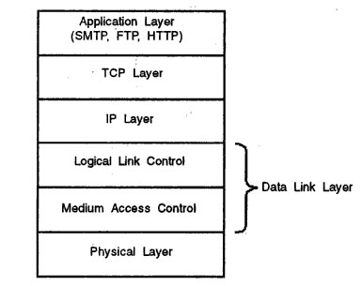
Ethernet
Fig 9. Ethernet LAN Protocol Architecture

Slide 12
Ethernet
Physical layer: The Ethernet physical layer specifies a RJ 45 jack using which the device is connected to the Local Area Network. Unshielded twisted pair or coaxial cable can be used as the medium. In each pair, one wire carries signal voltage between 0 to +2.5 volts and the second wire carries signals with voltage between —2.5 volts and 0 volts, and hence the signal difference is 5 volts. Speeds of 10 Mbps and 100 Mbps are supported.

Slide 13
Ethernet
Data link layer: The data link layer is divided into Medium Access Control (MAC) layer and Logical Link Control (LLC) layer. The MAC layer uses the Carrier Sense Multiple Access/Collision Detection (CSMA/CD) protocol to access the shared medium. The LLC layer specifies the protocol for logical connection establishment, flow control, error control and acknowledgements. Each Ethernet interface will have a unique Ethernet address of 48 bits.
To make the embedded system network-enabled, the upper layer protocols viz., TCP/IP stack has to run above the Ethernet. The TCP/IP stack has to be embedded along with the Operating System and application software in the firmware. If the embedded system has to send mails, Simple Mail Transfer Protocol (SMTP) has to run. To support file transfer application, File Transfer Protocol (FTP) software has to be ported. If the embedded system has to work as a web server, the HTTP server software has to run on the system.

Slide 14
IEEE 802.11
IEEE 802.11 family of standards is for Wireless Local Area Networks and Personal Area Networks.
These Standards cover the physical and MAC layers of Wireless LANs.
The LLC layer is same as for the Ethernet LAN.
Each Wireless LAN node an antenna to radiate waves.
All the nodes-running the same MAC protocol and competing to access the same medium will form a Basic Service Set (BSS).
This BSS can interface to a backbone LAN through Access Point (AP).
The backbone LAN can be a wired LAN such as Ethernet LAN.
Two or more BSSs can be interconnected through the backbone LAN. Access Points are also referred as "Hotspots".

Slide 15
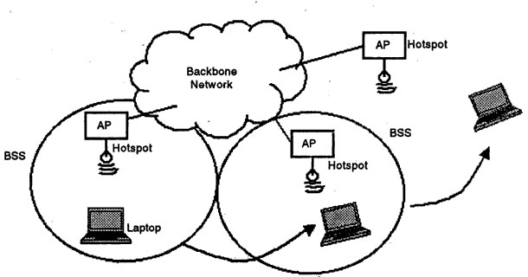
IEEE 802.11
Fig 10. IEEE 802.11 Wireless LAN

Slide 16
IEEE 802.11
The physical medium specifications for 802.11 WLANs are:
Diffused Infrared with operating wavelength between 850 and 950 nm. The data rate supported using this medium is 1 Mbps to 2 Mbps.
Direct Sequence Spread Spectrum operating in 2.4 GHz ISM band. Up to 7 channels each with a data rate of 1 Mbps or 2 Mbps can be used.
Frequency hopping spread spectrum operating in 2.4 GHz ISM band with 1 Mbps data rate to 2 Mbps.

Slide 17
IEEE 802.11
ISM band (2400 - 2483.5 MHz) is a 'free' band and hence no government approvals are required to operate radio systems in this band.
802.11b standard supports data rates up to 22 Mbps at 2.4 GHz, with a range of 100 meters.
802.11a, operates in the 5 GHz frequency band and can support data rates up to 54 Mbps, with a range of 100 meters.
802.11g supports 54 Mbps data rates in the 2.4 GHz band.

Slide 18
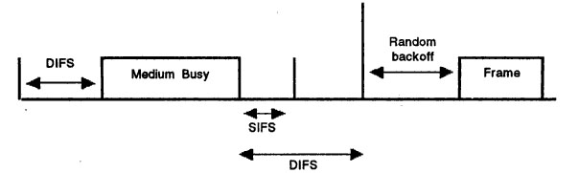
IEEE 802.11
Fig 11. CSMA/CA Protocol

Slide 19
IEEE 802.11
The MAC protocol used in 802.11 is called CSMA/CA (Carrier Sense Multiple Access with Collision Avoidance).
Before transmitting, a node senses the radio medium and if the channel is free for a period longer than a pre-defined value DIFS, the node transmits immediately.
If the channel is busy, the node keeps sensing the channel and if it is free for a period of DIFS, the node waits for some more period called random back-off interval and then transmits its frame.
When the destination receives the frame, it has to send an acknowledgement (ACK).
To send the ACK, the destination will sense the medium and if it is free for a pre-defined short time SIFS, the ACK is sent.
If the ACK does not reach the station, the frame has to be retransmitted using the above procedure.
A maximum of 7 retransmissions are allowed after which the frame is discarded. This procedure is known as CSMA/CA.

Slide 20
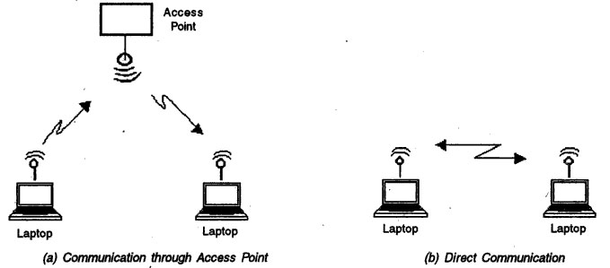
IEEE 802.11
Fig 12. Communication between nodes in Wireless LAN

Slide 21
IEEE 802.11
An important feature of IEEE 802.11 wireless LAN is that two or more nodes can communicate directly also without the need for a centralized control.
In Fig. 12(a), the configuration uses the Access Point as described earlier.
In Fig. 12(b), direct communication between two devices is shown.
When two or more devices form a network without the need for centralized control, they are called ad hoc networks.
Embedded systems are now being provided with wireless LAN connectivity to exchange data.
The main attraction of wireless connectivity is that it can be used in environments where running a cable is difficult such as in shop floors of manufacturing units.

Slide 22
Bluetooth
Devices such as desktop, laptop, printer, modem, mobile phone, etc are interconnected through wires for using a service (e.g. a print service) or for sharing information (e.g. transferring a file from desktop to laptop).
These devices form a Personal Area Network (PAN).
When we bring two devices close to each other, these two can automatically form a network and exchange data.
The networks, formed spontaneously by coming closer of two or more devices, are termed as ad-hoc networks.

Slide 23
Bluetooth
In an ad-hoc network, the topology may change dynamically with time, and the number of nodes in the network may also change with time.
If these devices are made to communicate through radio links and also if one device discover other devices, such networks can be administered easily.
A number of technologies have been proposed for PANs. Notable among them are Bluetooth, IrDA and IEEE 802.11.
Bluetooth holds a great promise because it can provide wireless connectivity to embedded systems at a very low cost.

Slide 24
Bluetooth
The salient features of Bluetooth technology are:
It is a low-cost technology—its cost will soon be as low as a cable connection. Since most of the Bluetooth-enabled devices have to operate through a battery, the power consumption is also very low.
It is based on radio transmission in the ISM band. ISM band is not controlled by any government authority and hence no special approval is required to use Bluetooth radio systems.
It caters to short ranges. The range of a Bluetooth device is typically 10 meters, though with higher power, the range can be increased to 100 meters.
It is based on open standards formulated by a consortium of industries and a large number of equipment vendors are committed to this technology.

Slide 25
Bluetooth
Most of electronic devices can be Bluetooth-enabled.
These include a PC, laptop, PDA, digital camera, mobile phone, pager, MP3 player, headset, printer, keyboard, mouse, LCD projector, domestic appliances such as TV, microwave oven, music players etc.
To make a device Bluetooth-enabled, a module containing the Bluetooth hardware and firmware is attached to the device. And, a piece of software is run on the device.
A Bluetooth-enabled device communicates with another Bluetooth-enabled device over the radio medium to exchange information or transfer data.

Slide 26
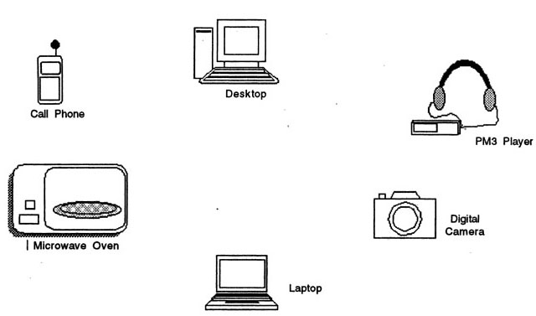
Bluetooth
Fig 13. Wireless PAN

Slide 27
Bluetooth
A set of devices can form a Personal Area Network if they are in the radio vicinity of each other
When a device comes in the vicinity of another device, Bluetooth protocols facilitate their forming a network.
A device can find out what services are offered by the other device and then obtain that service.
Such networks are called ad-hoc networks as the network is formed on the fly and once the device gets out of sight, the network is no longer there.
Such networks can be formed in office, at home, in cars and also in public places such as shopping malls, airports etc

Slide 28
Bluetooth
Bluetooth System Specification
Frequency of operation: operate in the ISM band in the frequency range 2400 -2483.5 MHz . This band consists of 79 channels each of 1 MHz bandwidth, with a lower guard band of 2 MHz and upper guard band of 3.5 MHz. When a device transmits its data, it uses frequency hopping, i.e. the device transmits each packet in a different channel. The receiving device has to switch to that channel to receive that packet. Though the radio design becomes complex when frequency hopping is used, the advantage is that it provides secure communication.

Slide 29
Bluetooth
Modulation: Gaussian Frequency Shift Keying (GFSK) is used as the modulation technique. Binary 1 is represented by a positive frequency deviation and 0 by negative frequency deviation. The radio receiver has to be designed in such a way that the Bit Error Rate (BER) of minimum 0.1% is ensured, i.e. the radio should provide a link which ensures that there will not be more than 1 error for every 1000 bits transmitted.
Operating range: Class 1 devices transmit maximum of 100 mW. The range of such devices is 100 meters. Class 2 devices transmit 10 mW. The range is 50 meters. Class 3 devices transmit 1 mW. The range is 10 meters.

Slide 30
Bluetooth
Services supported: Both data and voice services are supported by Bluetooth devices. For voice communication, Synchronous Connection Oriented (SCO) links are used which support circuit switching operation. For data communication, Asynchronous Connection Less (ACL) links are used which use packet switching. The SCO links carry voice. There is no retransmission of voice packets if they are lost or received in error.
For data services, devices exchange data in the form of packets. The receiving device acknowledges the packet or reports that the packet is received in error. If a packet is received with errors, the packet is retransmitted. It is also possible to broadcast packets by one device to all the other devices in the network. However, in broadcast mode there is no acknowledgement or indication that the packet is received with errors. The broadcasting device informs the receiving devices how many times a broadcast packet will be transmitted so that at least once every device will receive the packet without errors.

Slide 31
Bluetooth
Data rates: A Bluetooth device can support three synchronous voice channels and one asynchronous data channel. For voice communication, 64 Kbps data rate is used in both directions. For asynchronous links, two types of channels are defined with different data rates. In asymmetric channel, data rates are 723.2 Kbps in one direction and 57.6 Kbps in the other direction. In symmetric channel, data rate is 433.9 Kbps in both directions.
Network topology: In a PAN, a set of devices form a small network called piconet. In a piconet, there will be one Master and one or more Slaves. The Master decides the hop frequency sequence and all the Slaves tune to these frequencies to establish communication links. Any device can be a Master or Slave. It is also possible for a Master and Slave to switch roles—a Slave can become a Master. A piconet can have maximum number of seven slaves which can actively communicate with the Master. In addition to these active slaves, a piconet can contain many Slaves that are in parked mode. These parked devices are synchronized with the Master, but they are not active on the channel. The communication between the Master and the Slave uses Time Division Duplex (TDD).

Slide 32
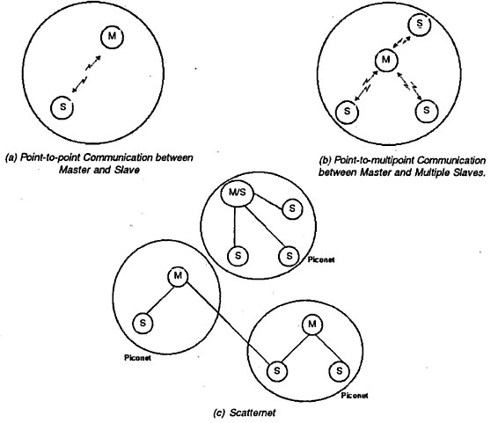
Fig 14. Bluetooth Piconet and Scatternet

Slide 33
Bluetooth
A scatternet is formed by a number of piconets. In this scatternet, each piconet will have a Master and a number of Slaves. The Master of a piconet can be a Slave in another piconet. Each piconet in the scatternet will have its own frequency hopping sequence and hence there will be no interference between two piconets. In a scatternet, even if the coverage areas of two piconets overlap, there will be no interference.

Slide 34
Bluetooth
Communication between Master and Slave: They communicate in the form of packets. Each packet is transmitted in a time slot. Each time slot is of 625 microseconds duration. These slots are numbered from 0 to 2²⁷-1. Master starts the transmission in even slots by sending a packet addressed to a slave and the slave sends the packets in odd numbered slots. A packet generally occupies one time slot, but can extend up to five slots. If the Master starts the transmission in slot 0 using frequency f1, the slave transmits in slot 1 using frequency f2, master transmits in slot 2 using frequency f3, and so on.

Slide 35
Bluetooth
States of Bluetooth Devices
Inquiry State: An application program in a Bluetooth device can enter the inquiry state to enquire about other devices in the vicinity.
Inquiry Scan State: To respond to an inquiry, the devices should periodically enter into inquiry scan state.
Inquiry Response State: when the inquiry is successfully completed, they enter the inquiry response state.
Page State: When a device wants to get connected to another device, it enters the page state. In this state, the device will become the Master and page for other devices. The command for this paging has to come from an application program running on this Bluetooth device.

Slide 36
Bluetooth
Master Response State: When the device pages for the other device, the other device may respond and the Master enters the master response state.
Page Scan State: Devices should enter the page scan state periodically to check whether other devices are paging for them.
Slave Response State: When device receives the page scan packet, it enters the slave response state.
Connection: Once paging of devices is completed, the Master and the Slave establish a connection. Thereafter, the connection is in active state, during which the packet transmission takes place. The connection can also be put in one of the three modes: 'hold' or 'sniff or 'park'

Slide 37
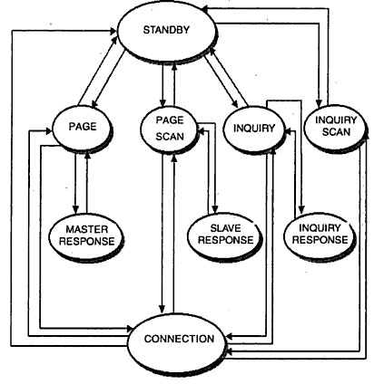
Fig 15. Bluetooth State Transition Diagram

Slide 38
Bluetooth
In hold mode, the device will stop receiving the data traffic for a specific amount of time so that other devices in the piconet can use the channel. After the expiry of the specific time, the device will start listening to traffic again.
In sniff mode, Device need not to listen to all the packets but only packets specified by sniff parameters.
In park mode the device only listens to a beacon signal from the Master occasionally, and it synchronizes with the Master but does not do any data transmission.

Slide 39
Bluetooth
A typical procedure for setting up a Bluetooth link can be:
The device sends an inquiry using a special inquiry hopping sequence.
Inquiry scanning devices respond to the inquiry by sending a packet. This packet contains the information needed to connect to it.
The inquiring device requests a connection to the device that responded to the inquiry.
Paging is used to initiate the connection with the selected device.
The selected device that has entered the page scan state responds to the page.
If the responding device accesses the connection, it synchronizes with the Masters timing and frequency hopping sequence.

Slide 40
Bluetooth
Bluetooth Addressing: Each Bluetooth module (the radio transceiver) is given a 48-bit address containing three fields: LAP (Lower Address Part) with 24 bits, Upper address part (UAP) with 8 bits and Non-Significant Address Part with 16 bits. This address is assigned by the manufacturer of the Bluetooth module and consists of company ID and company assigned number. This address is unique to every Bluetooth device. In Bluetooth specifications, this address is referred to as BD_ADDR.
Each active member in a piconet will have a 3-bit address. The parked members also need to have addresses so that the master can make them active for exchange of packets. Parked member address is either the BD_ADDR of 48 bits or an 8-bit parked member address denoted by PM_ADDR.

Slide 41
Bluetooth
Bluetooth profiles: To ensure interoperability between devices manufactured by different vendors, Bluetooth SIG released the Bluetooth 'profiles' which define the precise characteristics and protocols supported by these devices. The Bluetooth profiles are defined for headset, cordless phone, fax machine, LAN Access Point, serial communication, dial-up networking, file transfer, synchronization of data between two devices, etc.

Slide 42
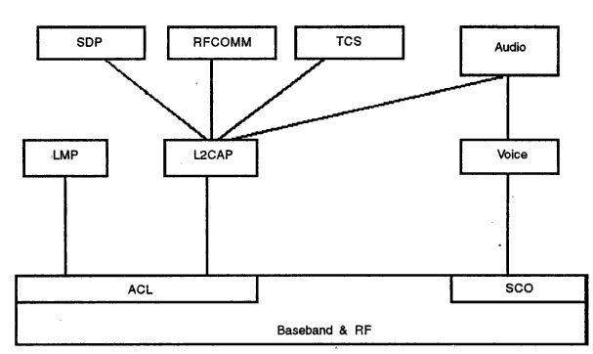
Fig 16. Bluetooth Protocol Architecture

Slide 43
Bluetooth
Bluetooth Protocol Architecture
Baseband and RF
The baseband layer is for establishing the links between devices based on the type of service required— ACL for data services and SCO for voice services. It also takes care of addressing and managing the different states of the Bluetooth device. The RF portion provides the radio interface.
Link Manager Protocol (LMP)
This is used to set up and control links. The three layers—RF, Link controller and the Link manager—will be on the Bluetooth module attached to the device. The link manager on one device exchanges messages (LMP messages )with the link manager on the other device. Link messages have higher priority compared to data. The functions of the LMP are as follows:

Slide 44
Bluetooth
Authentication
Encryption
Clock offset request
Timing accuracy information request
LMP version
Type of packets supported
Switching Master/Slave role
Name request
Detach
Hold mode
Park mode
Power control
Request SCO link
Quality of Service (QoS) parameters exchange
Multi-slot packet control
Link supervision
Connection establishment

Slide 45
Bluetooth
Logical Link Control and Adaptation Protocol (L2CAP)
L2CAP runs above the baseband and carries our the data link layer functionality. L2CAP layer is only for ACL links. L2CAP data packets can be up to 64 Kilobytes long. L2CAP protocol runs on hosts such as laptop, cellular phone or other wireless devices.
The functions of L2CAP layer are:
Protocol multiplexing
Segmentation and reassembly:
Quality of Service:
L2CAP layer sends connection request and QoS request message from the application programs through the higher layers. It receives from the lower layers the responses for these requests. The responses can be: connection indication, connection confirmation, connect confirmation negative, connect confirmation pending, disconnect indication (from remote), disconnect confirmation, timeout indication and quality of service violation indication.

Slide 46
Bluetooth
Service Discovery Protocol
Provides the Bluetooth environment the capability to create ad hoc networks.
It is used for discovering the services offered by a device. SDP offers the following services:
A device can search for the service needed by it in the piconet.
A device can discover a service based on a class of services
Browsing of services.
Discovery of new services when devices enter in the radio range of other devices.
Mechanism to find out when a service becomes unavailable when the device goes out of radio range.
The details of services such as classes of services and the attributes of services.
To discover services on another device without consulting the third device.

Slide 47
Bluetooth
When a device wants to discover a service, the application software initiates the request (which is the client) and the SDP client sends SDP request to the server (the device which can provide the required service). SDP client and server exchange SDP messages.
The server maintains list of service records. Each record is identified by a unique 32-bit number. Service record will have a number of attributes like service class ID list (type of service), service ID, protocol description list (protocol used for using the service), provider name, Icon URL (an iconic representation of the service), service name and service description
Each attribute will have two components: attribute ID and attribute value.
Service Discovery Protocol (SDP)provides the capability to discover the availability of services in a Bluetooth network and to access these services.

Slide 48
Bluetooth
RFCOMM
RFCOMM is a transport protocol to emulate serial communication (RS232 serial port) over\L2CAP. Through RFCOMM, two devices can communicate using serial communication protocols over Bluetooth radio. To achieve this, RFCOMM emulates the 9 signals of RS 232. These signals are:
102 Signal Ground (GND)
103 Transmit Data (TD)
104 Received Data (RD)
105 Request to Send (RTS)
106 Clear to Send (CTS)
107 Data Set Ready (DSR)
108 Data Terminal Ready (DTR)
109 Data Carrier Detect (DCD) 125
125 Ring Indicator (RI)
IT supports two types of devices. Type 1 devices are communication end-points such as computers and printers. Type 2 devices are part of communication segment such as modems.

Slide 49
Bluetooth
Telephony Control Protocol Specifications (TCS)
Handles signaling information to establish voice and data calls between Bluetooth devices.
This protocol is based on the International Telecommunications Union (ITU) standard Q.931, which is the standard for signaling in Integrated Services Digital Network (ISDN).
TCS messages are exchanged between devices to establish and release connections and to provide supplementary services such as calling line identification (to identify the telephone number of the calling subscriber).

Slide 50
Bluetooth
Host Control Interface
Bluetooth device will have two parts: a module implementing the lower layers (LMP and below) and a software module implementing higher layers stack (L2CAP and above). The Host Controller Interface (HCI) provides a standard interface between the Bluetooth module and the host software, so that we can buy the hardware module from one vendor and software module from another vendor. HCI uses three types of packets:
commands which are sent from the host to the module,
Events which are sent from the module to the host, and
Data packets which are exchanged between the host and the module.
The functions of HCI are
setting up and disconnection of the links and configuring the links.
Control of baseband features such as timeouts.
Retrieving of status information of the module.
Invoking the test modes to test the module for local testing of Bluetooth devices.

Slide 51
Bluetooth
The HCI commands can be categorized as
Link control commands to establish piconets and scatternets
Link policy commands to put devices in hold mode or sniff mode
Commands to get information about the local hardware
Commands to get the status parameters
Commands to test the local Bluetooth module.

